Slide 1
Seeking The Highest First
with Dustin Matthews

Slide 2
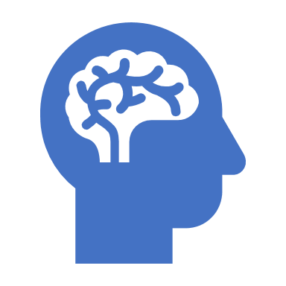
Sleep, Psychology, and Thy Self
Importance of sleep and meditation
Humans’ psychological and biological needs
Notes:
In this lesson, we will discuss the importance of sleep and meditation as well as an understanding of humans psychological and biological needs.

Slide 3
Maslow’s Hierarchy of Needs
Notes:
Instead of focusing on psychopathology and what goes wrong with people, Maslow (1943) formulated a more positive account of human behavior which focused on what goes right. He was interested in human potential, and how we fulfill that potential.
Psychologist Abraham Maslow (1943, 1954) stated that human motivation is based on people seeking fulfillment and change through personal growth. Self-actualized people are those who were fulfilled and doing all they were capable of.
1. Physiological needs - these are biological requirements for human survival, e.g. air, food, drink, shelter, clothing, warmth, sex, sleep.
If these needs are not satisfied the human body cannot function optimally. Maslow considered physiological needs the most important as all the other needs become secondary until these needs are met.
2. Safety needs - protection from elements, security, order, law, stability, freedom from fear.
3. Love and belongingness needs - after physiological and safety needs have been fulfilled, the third level of human needs is social and involves feelings of belongingness. The need for interpersonal relationships motivates behavior
Examples include friendship, intimacy, trust, and acceptance, receiving and giving affection and love. Affiliating, being part of a group (family, friends, work).
4. Esteem needs - which Maslow classified into two categories: (i) esteem for oneself (dignity, achievement, mastery, independence) and (ii) the desire for reputation or respect from others (e.g., status, prestige).
Maslow indicated that the need for respect or reputation is most important for children and adolescents and precedes real self-esteem or dignity.
5. Self-actualization needs - realizing personal potential, self-fulfillment, seeking personal growth and peak experiences. A desire “to become everything one is capable of becoming”(Maslow, 1987, p. 64).

Slide 4
Notes:
Growth needs do not stem from a lack of something, but rather from a desire to grow as a person. Once these growth needs have been reasonably satisfied, one may be able to reach the highest level called self-actualization.
Every person is capable and has the desire to move up the hierarchy toward a level of self-actualization. Unfortunately, progress is often disrupted by a failure to meet lower level needs. Life experiences, including divorce and loss of a job, may cause an individual to fluctuate between levels of the hierarchy.
Therefore, not everyone will move through the hierarchy in a uni-directional manner but may move back and forth between the different types of needs.
1. Biological and physiological needs - air, food, drink, shelter, warmth, sex, sleep, etc.
2. Safety needs - protection from elements, security, order, law, stability, etc.
3. Love and belongingness needs - friendship, intimacy, trust, and acceptance, receiving and giving affection and love. Affiliating, being part of a group (family, friends, work).
4. Esteem needs - which Maslow classified into two categories: (i) esteem for oneself (dignity, achievement, mastery, independence) and (ii) the desire for reputation or respect from others (e.g., status, prestige).
5. Cognitive needs - knowledge and understanding, curiosity, exploration, need for meaning and predictability.
6. Aesthetic needs - appreciation and search for beauty, balance, form, etc.
7. Self-actualization needs - realizing personal potential, self-fulfillment, seeking personal growth and peak experiences.
8. Transcendence needs - A person is motivated by values which transcend beyond the personal self (e.g., mystical experiences and certain experiences with nature, aesthetic experiences, sexual experiences, service to others, the pursuit of science, religious faith, etc.).

Slide 5
What Are Your Needs?
Maslow: Human motivation is based on seeking fulfillment and change through personal growth
Maharishi:
The nature of life is to grow.

Slide 6
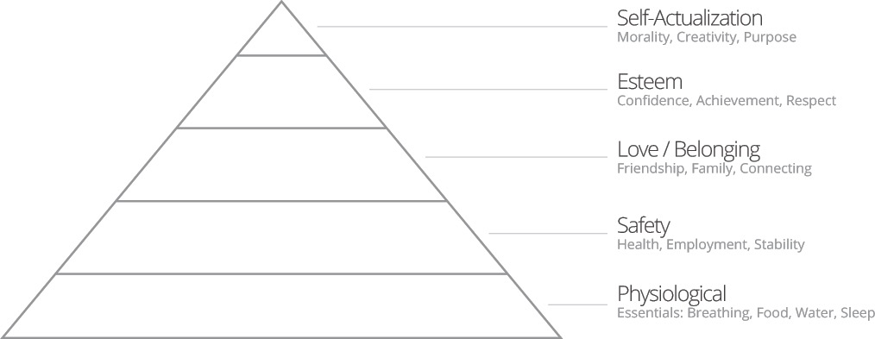
Self-Referral?
Notes:
Print Out for class Exercise. Rate 1-5. 1-Never, 2-Rarely, 3-Sometimes, 4- Mostly, 5-Always
Write Down the Areas you feel you are accomplished in and what areas you would like to see improvement.
What needs/desires do you have in your life right now?

Slide 7
The Magic 4
My Best Friend S.T.A.N.
Sleep
Transcendental Meditation
Activity
Nutrition

Slide 8
The Magic 4
Don’t forget your M.E.D.S.
Meditation
Exercise
Diet
Sleep

Slide 9

Sleep
1/4 to 1/3 of our life span
Two regulators
Circadian Rhythms
Sleep Drive
https://www.hopkinsmedicine.org/health/wellness-and-prevention/the-science-of-sleep-understanding-what-happens-when-you-sleep
Notes:
Sleep accounts for 1/4 to 1/3 of a humans life span.
Two processes that regulate sleep: Circadian Rhythms and Sleep Drive

Slide 10
Sleep
Used to be thought of as a passive activity where nothing happens
Science has found sleep vital role to development and recovery of brain and body
https://www.hopkinsmedicine.org/health/wellness-and-prevention/the-science-of-sleep-understanding-what-happens-when-you-sleep
Notes:
Sleep used to be thought of as a passive activity where nothing happens but science has found that sleep plays a vital role in the development and recovery of our brain and body.

Slide 11
Sleep
Brain cycles through different stages of sleep: Non-REM sleep and REM (rapid-eye movement)
Notes:
Throughout our time asleep, our brains will cycle repeatedly through different stages of sleep: Non-REM sleep and REM (rapid-eye movement)

Slide 12

Non-Rem Sleep
Stage 1: Between being awake and falling asleep (5-10 mins)
Stage 2: Light sleep — heart rate and breathing slow, body temperature drops
Stages 3-4: Deep sleep —repair and regrow tissues, build bone and muscle, strengthen immune system
https://www.sleep.org/articles/what-happens-during-sleep/
Notes:
As you get older, you sleep more lightly and get less deep sleep. Aging is also linked to shorter time spans of sleep, although studies show you still need as much sleep as when you were younger.

Slide 13
REM Sleep (Rapid Eye Movement)
About 90 minutes after initially falling asleep
Each REM stage lasts up to an hour
Average: 5-6 REM cycles/night
Brain more active — dreaming
Eyes jerk, heart rate and blood pressure increase, breathing can be fast, irregular, shallow
Notes:
During this final phase of sleep, your brain becomes more active. This is when most dreaming occurs, your
We enter REM sleep about 90 minutes after initially falling asleep and each REM stage can last up to an hour.
An average adult has five to six REM cycles each night.
During REM Sleep our brains become more active and this is when dreaming occurs.
Our eyes jerk quickly in different directions, heart rate and blood pressure increase, and breathing can become fast, irregular, shallow.

Slide 14
Normal Sleep Patterns in Young Adults
REM Stage
NREM
AWAKE
REM
1
Sleep Stages
2
3
4
1
2
3
4
5
6
7
8
Hours of Sleep
Notes:
Adapted from Berger RJ. The sleep and dream cycle. In: Kales A, ed. Sleep Physiology & Pathology: A Symposium. Philadelphia: J.B. Lippincott; 1969. Used by permission of Lippincott Williams & Wilkins.
Breakdown of total time at each stage
Stage 1: 5%
Stage 2: 50%
Stages 3, 4: 20%
REM: 20%-25%

Slide 15
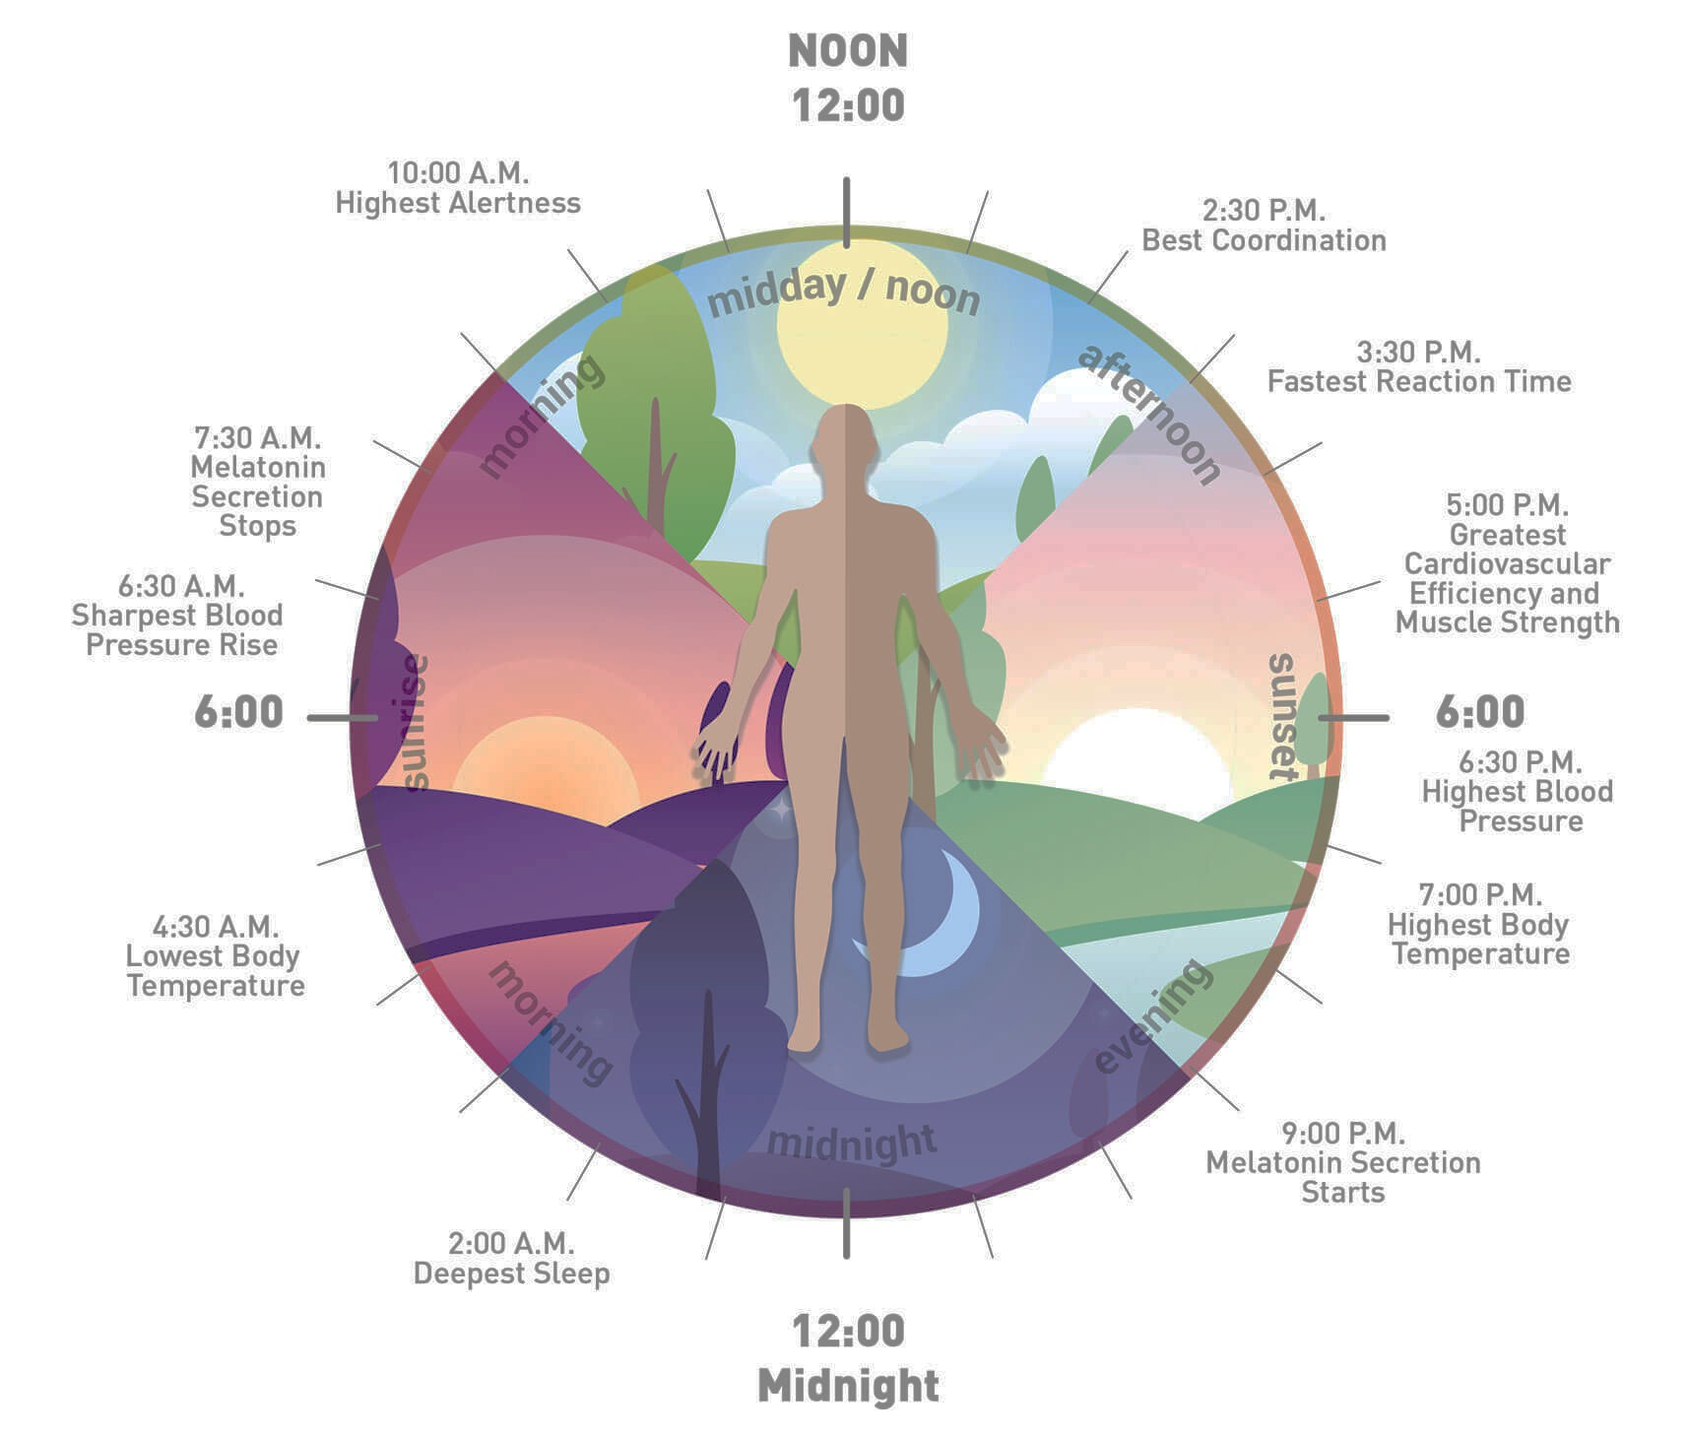
Circadian Rhythm
24-hour internal clock
cycles between sleepiness and alertness
“Sleep/wake cycle”
Notes:
Your Body’s Built-In Sleep Controls
Circadian rhythm is basically a 24-hour internal clock that is running in the background of your brain and cycles between sleepiness and alertness at regular intervals. It's also known as your sleep/wake cycle.
Circadian rhythms are controlled by a biological clock located in the brain. One key function of this clock is responding to light cues, ramping up production of the hormone melatonin at night, then switching it off when it senses light. People with total blindness often have trouble sleeping because they are unable to detect and respond to these light cues.

Slide 16
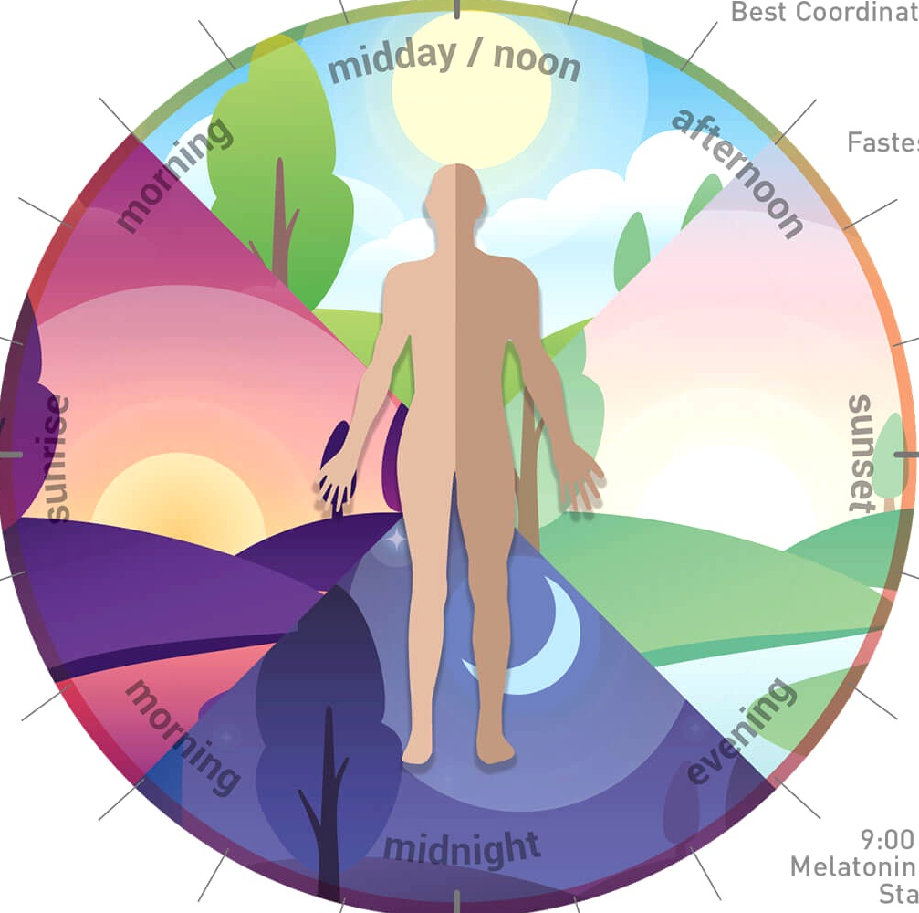
10 AM
Highest Alertness
2:30 PM
Best coordination
9:30 AM
Melatonin secretion stops
3:30 PM
Fastest reaction time
6:30 AM
Sharpest blood pressure rise
5 PM
Peak cardio efficiency, muscle strength
4:30 AM
Lowest body temperature
6:30 - 7 PM
Peak blood pressure, temp
9 PM
Melatonin secretion starts
2 AM
Deepest sleep
Notes:
Your Body’s Built-In Sleep Controls
Circadian rhythm is basically a 24-hour internal clock that is running in the background of your brain and cycles between sleepiness and alertness at regular intervals. It's also known as your sleep/wake cycle.
Circadian rhythms are controlled by a biological clock located in the brain. One key function of this clock is responding to light cues, ramping up production of the hormone melatonin at night, then switching it off when it senses light. People with total blindness often have trouble sleeping because they are unable to detect and respond to these light cues.

Slide 17
Sleep Drive or Sleep Urge
Notes:
Sleep drive also plays a key role: Your body craves sleep, much like it hungers for food. Throughout the day, your desire for sleep builds, and when it reaches a certain point, you need to sleep. A major difference between sleep and hunger: Your body can’t force you to eat when you’re hungry, but when you’re tired, it can put you to sleep, even if you’re in a meeting or behind the wheel of a car. When you’re exhausted, your body is even able to engage in microsleep episodes of one or two seconds while your eyes are open. Napping for more than 30 minutes later in the day can throw off your night’s sleep by decreasing your body’s sleep drive

Slide 18
11,000
10,000
Sweden
N = 74,927
No. of Errors
9000
8000
7000
6000
5000
4000
12M
6 AM
12N
6 PM
12M
Notes:
Figure represents the distribution of 75,000 meter-reading errors displayed as a function of time.
These data were collected in Swedish gas works and assessed the 24-hour distribution of 75,000 meter-reading errors during a 20-year period. Notice the familiar 2-peak, or bimodal, pattern of these errors:
Major peak occurs between 2 AM and 4 AM
Minor peak occurs between 2 PM and 4 PM

Slide 19
1200
1000
800
600
400
200
No. of Accidents
International Data
N = 6052
12M
6 AM
12N
6 PM
12M
Notes:
Distribution of 6052 single-vehicle accidents displayed as a function of time of day. These accidents were judged by investigators to be attributable to “falling asleep at the wheel.” Notice the familiar 2-peak, or bimodal, pattern of the accident rate over time:
Major peak occurs between 12 AM and 7 AM (especially pronounced between 1 AM and 4 AM)
Minor peak occurs between 1 PM and 4 PM
These data combine population samples from:
Israel: n = 390
Texas: n = 4994
New York: n = 668

Slide 20
Vehicle Accident Data, Performance Errors, and Circadian Rhythm
12M
6 AM
12N
6 PM
12M
Notes:
This build of slides demonstrates the similarity in the temporal distribution of meter-reading errors and auto accidents and correlates the indirect relationship that poor function has to the maximum peaks of the circadian rhythm (times of greatest sleepiness).
At the maximum peak of sleepiness (12 AM-7 AM; 1 PM-4 PM), errors and accident rates are at their highest
At the minimum troughs of sleepiness (7 AM-11 AM; and 5 PM-11 PM), function is higher and errors and accidents occur less frequently

Slide 21
Epworth Sleepiness Scale
Situation | Chance of dozing
Sitting and reading | 0 | 1 | 2 | 3
Watching television | 0 | 1 | 2 | 3
Sitting inactive in a public place | 0 | 1 | 2 | 3
As a passenger in a car for an hour | 0 | 1 | 2 | 3
Lying down to rest in the afternoon | 0 | 1 | 2 | 3
Sitting and talking to someone | 0 | 1 | 2 | 3
Sitting quietly after lunch | 0 | 1 | 2 | 3
In a car, while stopped in traffic | 0 | 1 | 2 | 3
Total Score
0 = never
1 = slight chance
2 = moderate
3 = high chance
Notes:
The ESS asks the user, “How likely are you to doze off or fall asleep in the following situations, in contrast to just being tired? This refers to your usual way of life in recent times. Even if you have not done some of these things recently, try to work out how they would have affected you.” (Emphasis added.)
An ESS score of 10 points or higher is indicative of daytime sleepiness
An ESS score of 16 points or higher indicates a high level of daytime sleepiness

Slide 22
MIU Results

Slide 23
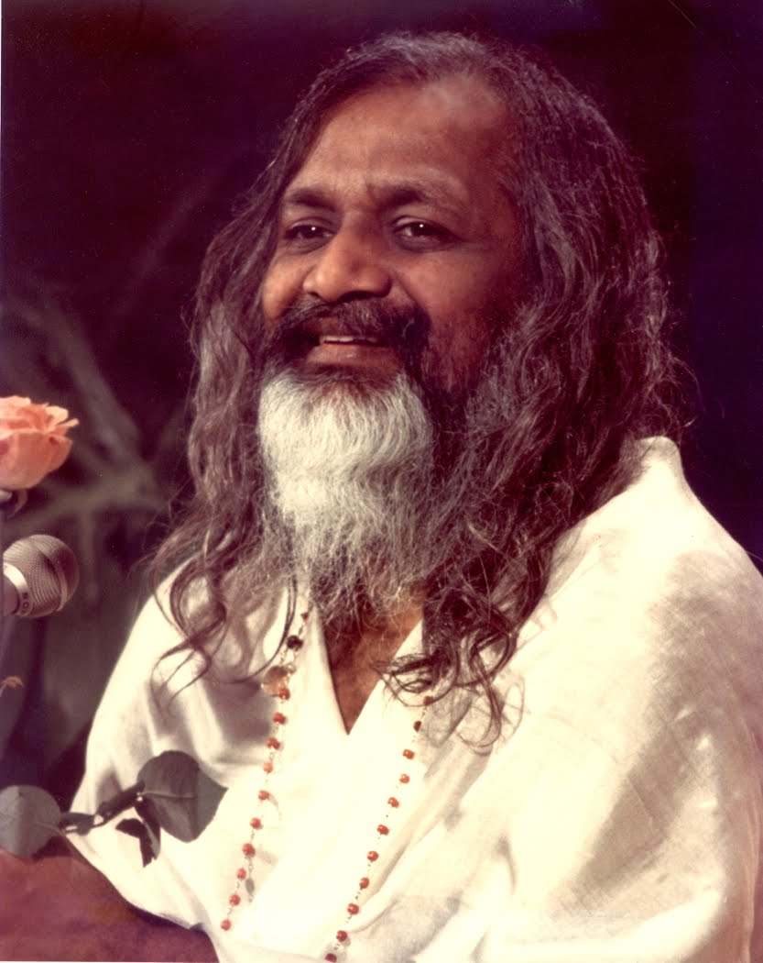
Sleep is the blessing of God,
Feel love of God,
Lie in the showers of His blessing.
Let your heart melt in the love of God.
Sleep in the thought of God and in the love.
It is not necessary to say anything,
But feeling of God is of maximum value.
The love flows.
Sleep is only at the surface.
Sleep in the warmth of Divine Grace
Without any words — only this feeling.
Maharishi (1962)

Slide 24
Recommended Sleep
Newborn | 0 – 3 months | 14 – 17 hours/day
Infants | 4 – 11 months | 12 – 15 hours
Toddlers | 1 – 2 years | 11 – 14 hours
Preschoolers | 3 – 5 years | 10 - 13 hours
School age | 6 – 13 years | 9 – 11 hours
Teenagers | 14 - 17 | 8 – 10 hours
Younger adults | 18 - 25 | 7 – 9 hours
Adults | 26 - 64 | 7 – 9 hours
Older adults | 65+ | 7 – 8 hours

Slide 25
Poor Sleep
Fat Gain
Heart Disease and Stroke
Depression
Increased Inflammation
Good Sleep
Eat Fewer Calories
Concentration and Productivity
Athletic Performance
Immune Function
Notes:
Poor Sleep Can Increase Fat Gain
2. Good Sleepers Tend to Eat Fewer Calories
3. Good Sleep Can Improve Concentration and Productivity
4. Good Sleep Can Maximize Athletic Performance
5. Poor Sleepers Have a Greater Risk of Heart Disease and Stroke
6. Sleep Affects Glucose Metabolism and Type 2 Diabetes Risk
7. Poor Sleep Is Linked to Depression
8. Sleep Improves Your Immune Function
9. Poor Sleep Is Linked to Increased Inflammation
10. Sleep Affects Emotions and Social Interactions

Slide 26
Sleep affects:
Glucose Metabolism
Type 2 Diabetes Risk
Emotions
Social Interactions
Notes:
Poor Sleep Can Increase Fat Gain
2. Good Sleepers Tend to Eat Fewer Calories
3. Good Sleep Can Improve Concentration and Productivity
4. Good Sleep Can Maximize Athletic Performance
5. Poor Sleepers Have a Greater Risk of Heart Disease and Stroke
6. Sleep Affects Glucose Metabolism and Type 2 Diabetes Risk
7. Poor Sleep Is Linked to Depression
8. Sleep Improves Your Immune Function
9. Poor Sleep Is Linked to Increased Inflammation
10. Sleep Affects Emotions and Social Interactions

Slide 27

Sleep
Set a consistent sleep schedule (even on weekends)
Shut off electronics and stimulation around 9:00 p.m.
Dark, cool setting no clocks in visual sight
Bed should be for sleeping only
If you can get to sleep around 10:00 p.m. waking up at 6:00 a.m. would be eight hours of sleep. This is ideal.

Slide 28
Why Is Sleep So Important?
Sleep Is Your Super Power

Slide 29
Transcendental Meditation
If we are able to meet these two requirements — regularity in meditation and leading a good life in society, day-to-day a good life — then nothing would be unattainable by us.
— Maharishi

Slide 31
TM / Self Referral
Notes:
TM allows individuals to access the top of the pyramid in Maslows model; Transcendence, which can illuminate the areas in ones life that might need more attention or care. TM is like the white light shining in through the prism or (our human body) and all of the colors that come out reflect our personality, skills, abilities and character.

Slide 32
Notes:
Growth needs do not stem from a lack of something, but rather from a desire to grow as a person. Once these growth needs have been reasonably satisfied, one may be able to reach the highest level called self-actualization.
Every person is capable and has the desire to move up the hierarchy toward a level of self-actualization. Unfortunately, progress is often disrupted by a failure to meet lower level needs. Life experiences, including divorce and loss of a job, may cause an individual to fluctuate between levels of the hierarchy.
Therefore, not everyone will move through the hierarchy in a uni-directional manner but may move back and forth between the different types of needs.
1. Biological and physiological needs - air, food, drink, shelter, warmth, sex, sleep, etc.
2. Safety needs - protection from elements, security, order, law, stability, etc.
3. Love and belongingness needs - friendship, intimacy, trust, and acceptance, receiving and giving affection and love. Affiliating, being part of a group (family, friends, work).
4. Esteem needs - which Maslow classified into two categories: (i) esteem for oneself (dignity, achievement, mastery, independence) and (ii) the desire for reputation or respect from others (e.g., status, prestige).
5. Cognitive needs - knowledge and understanding, curiosity, exploration, need for meaning and predictability.
6. Aesthetic needs - appreciation and search for beauty, balance, form, etc.
7. Self-actualization needs - realizing personal potential, self-fulfillment, seeking personal growth and peak experiences.
8. Transcendence needs - A person is motivated by values which transcend beyond the personal self (e.g., mystical experiences and certain experiences with nature, aesthetic experiences, sexual experiences, service to others, the pursuit of science, religious faith, etc.).

Slide 33
Notes:
Stanford University: A meta-analysis of 146 independent studies found that the Transcendental Meditation technique is twice as effective at reducing trait anxiety when compared with concentration, contemplation or other techniques.
Reference: Journal of Clinical Psychology, 45 (1989): 957–974.

Slide 34
Notes:
A statistical meta-analysis of 198 independent treatment outcomes found that the Transcendental Meditation program produced a significantly larger reduction in tobacco, alcohol, and nonprescribed drug use than standard substance abuse treatments and standard prevention programs. Whereas the effects of conventional programs typically fall off rapidly within 3 months, effects of the Transcendental Meditation program increase over time, with total abstinence from tobacco, alcohol, and nonprescribed drugs ranging from 51%–89% over a 18–22 month penod. The effects of the Transcendental Meditation program are based on fundamental and naturally occurring improvements in the individuals' psychophysiological functioning.

Slide 36
Benefits of TM
Reduced stress and anxiety
Improved sleep
Greater clarity and productivity
Lower blood pressure
Greater calmness throughout the day
Reduced cortisol
Lower risk of heart attack or stroke
Improved brain function and memory

Slide 37
What Has Your TM Experience Been Like?
When did you learn TM?
Are you a Sidha?
Are you regular in your TM?
How often do you meditate?
What has your experience been like?
Any benefits?

Slide 38
The practice of Transcendental Meditation creates a natural situation in the mind so that the mind entertains right thoughts, useful thoughts, thoughts that are cherished by nature and whose fulfillment is worked out by all the laws of nature.
— Maharishi

Slide 39
Consciousness
Consciousness

